Slide 1
Vocabulary #1
Standard vocabulary & Summer Movie Poster jargon

Slide 2
ameliorate (v)
to make better; to improve

Slide 3
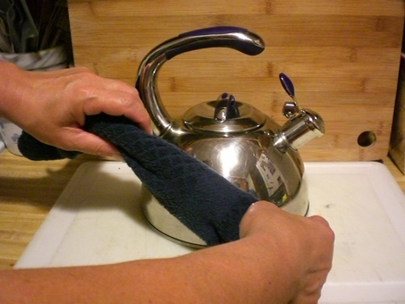
burnish (v)
to make or become smooth, bright, and glossy

Slide 4
cynic (n)
one who believes others are motivated entirely by selfishness

Slide 5
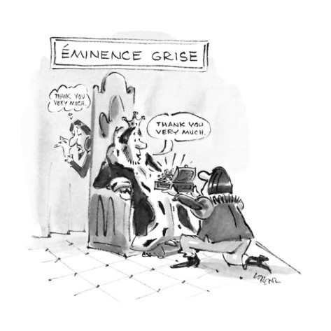
eminence (n)
superiority in position or rank

Slide 6
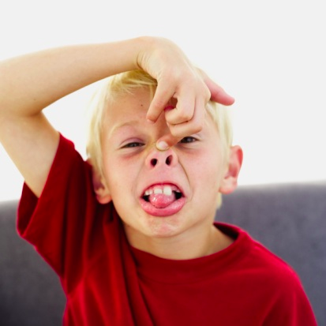
flippant (adj)
impertinent; disrespectful

Slide 7
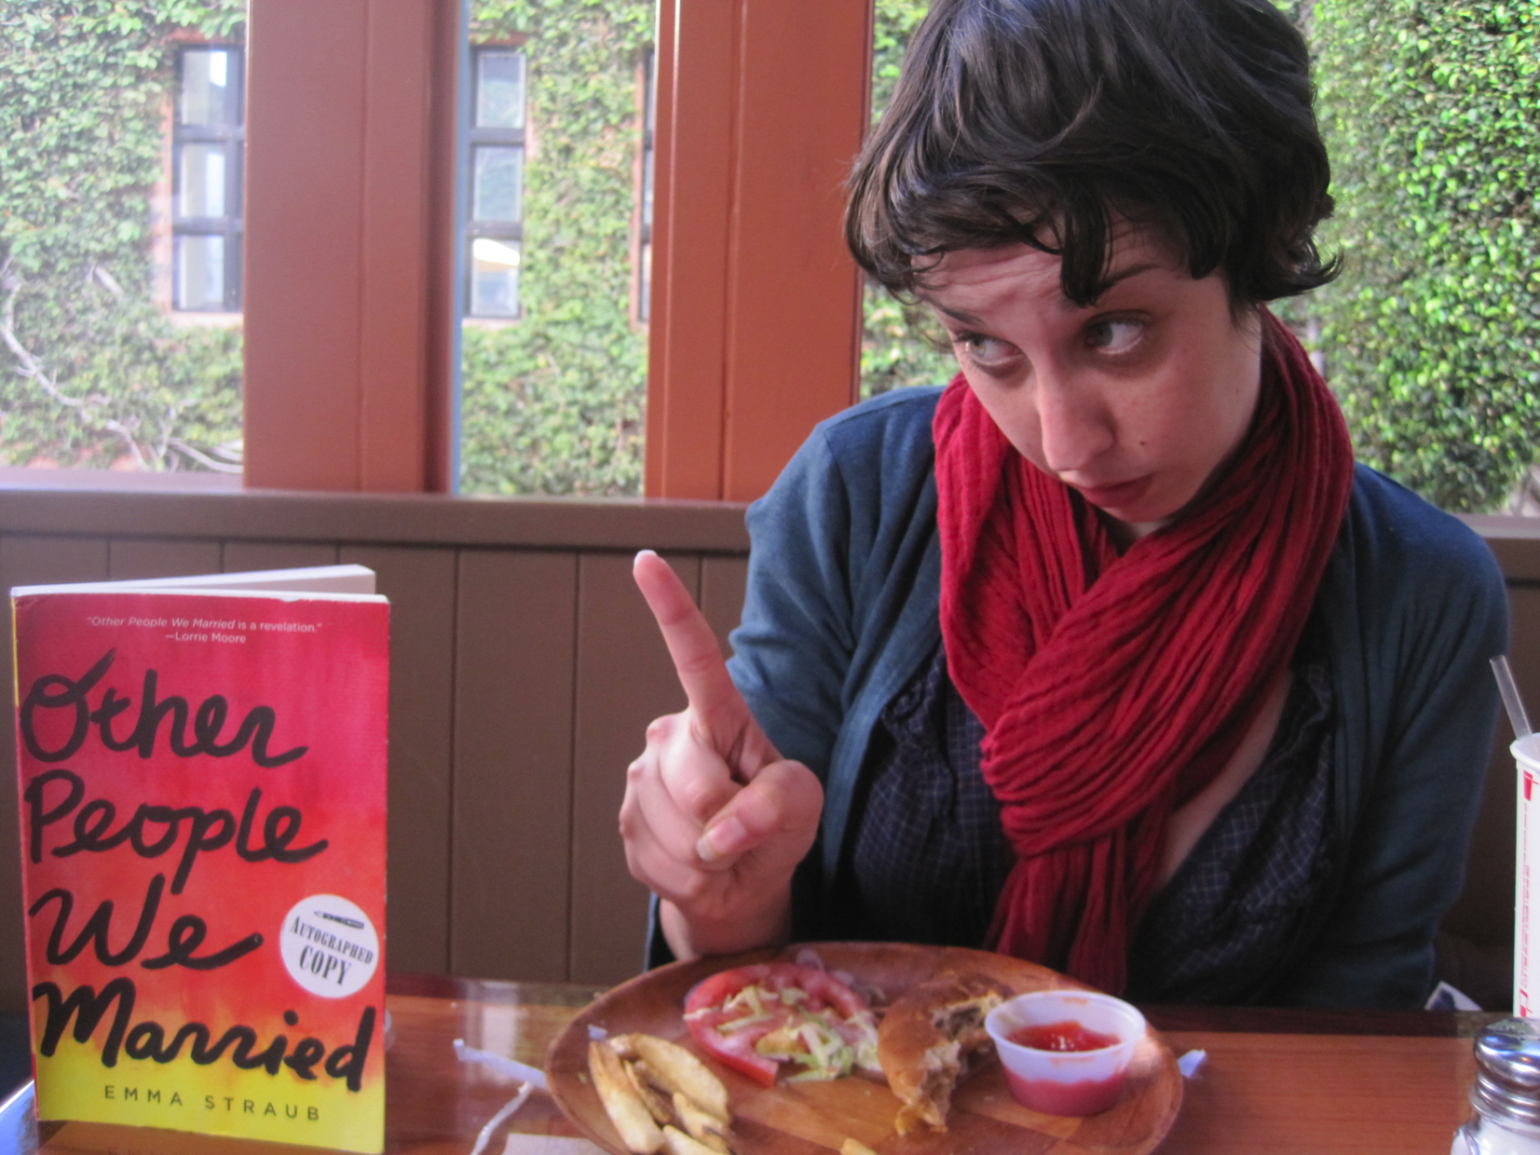
incisive (adj)
cutting into

Slide 8
litigate (v)
to contest in a lawsuit

Slide 9
pallid (adj)
pale; colorless

Slide 10
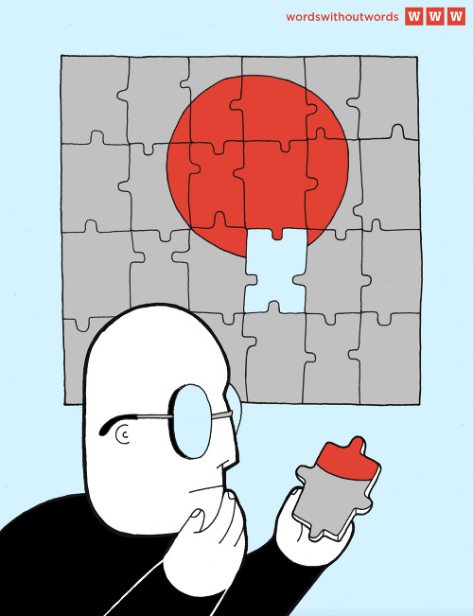
quandary (n)
dilemma; problem

Slide 11
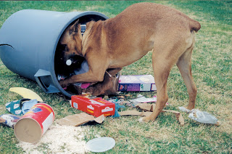
rummage (v)
search thoroughly

Slide 12
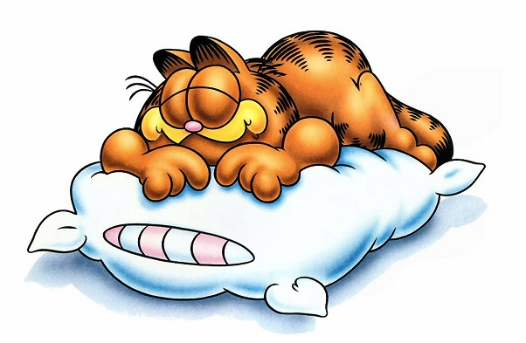
torpid (adj)
lacking alertness and activity; lethargic; lazy

Slide 13
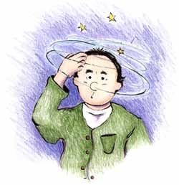
vertigo (n)
dizziness

Slide 14
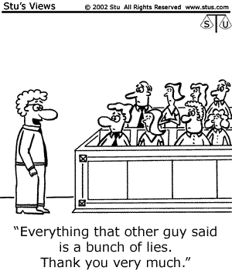
encapsulate (v)
to express something in concise form

Slide 15
entice (v)
tempt by offering something attractive

Slide 16
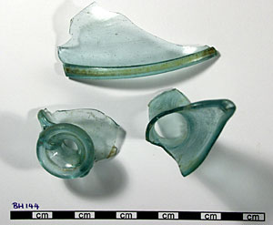
fragment (n)
broken piece; incomplete piece

Slide 17
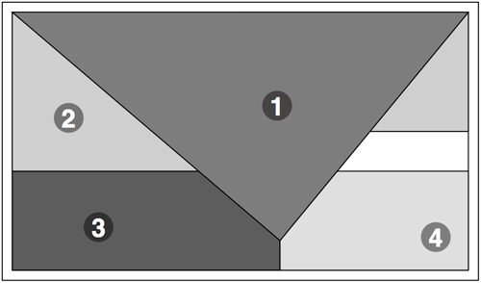
layout (n)
way things are arranged; design of printed matter

Slide 18
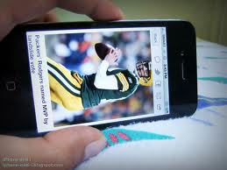
orientation (adj)
position or direction in which something lies

Slide 19
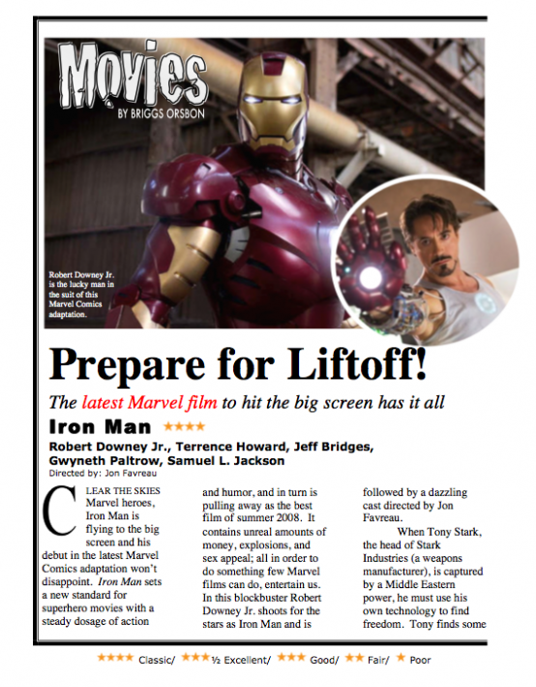
review (n)
to write a journalistic report on the quality of a new play, book, movie, concert, or other public performance

Slide 20
tag line (n)
a phrase repeatedly used in connection with a person, organization, or product, especially in publicity

Slide 21
teaser (n)
a preview intended to arouse curiosity and interest in a forthcoming broadcast or publication

