Slide 1
Vocabulary #14

Slide 2
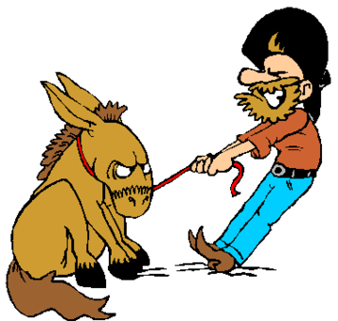
adamant (adj)
not yielding; firm
ad = to
man = hand

Slide 3
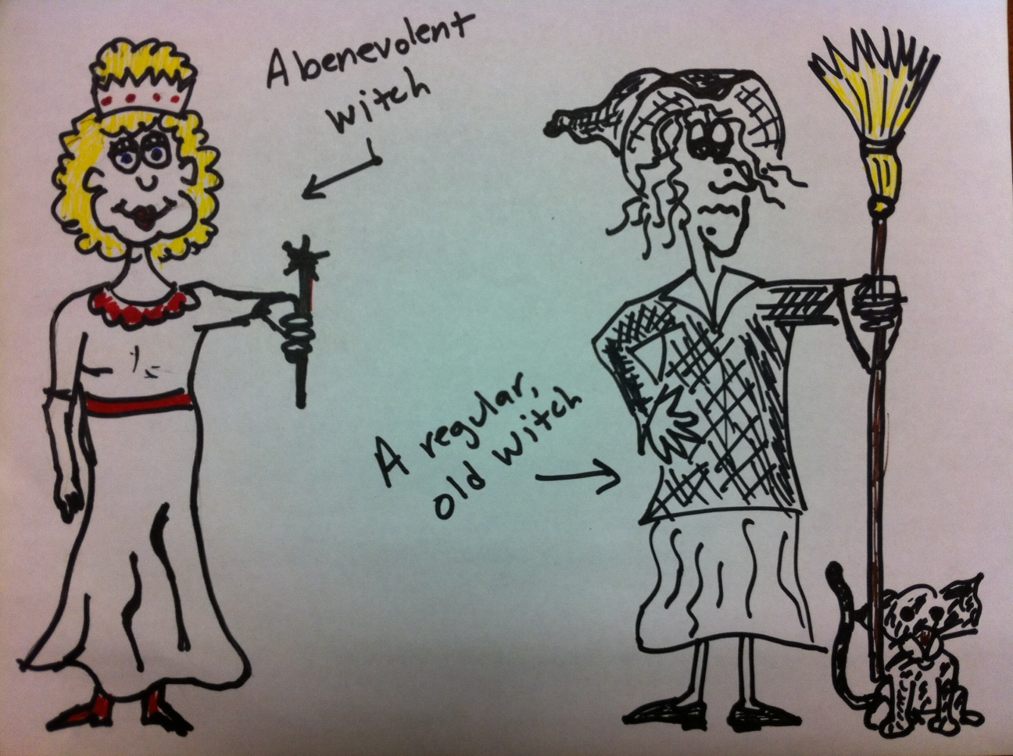
benevolent (adj)
kind; generous
bene = good
vol = will

Slide 4
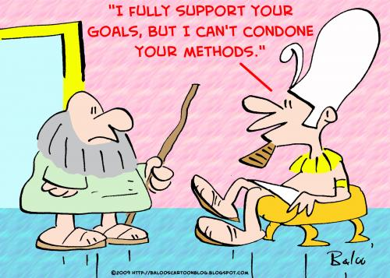
condone (v)
to overlook; forgive
con = together

Slide 5
disparage (v)
to belittle; undervalue
dis = away
par = equal

Slide 6
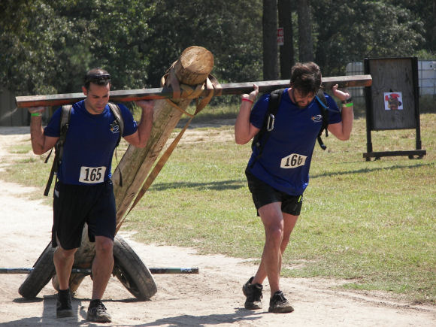
facilitate (v)
make easier; simplify
ate = cause

Slide 7
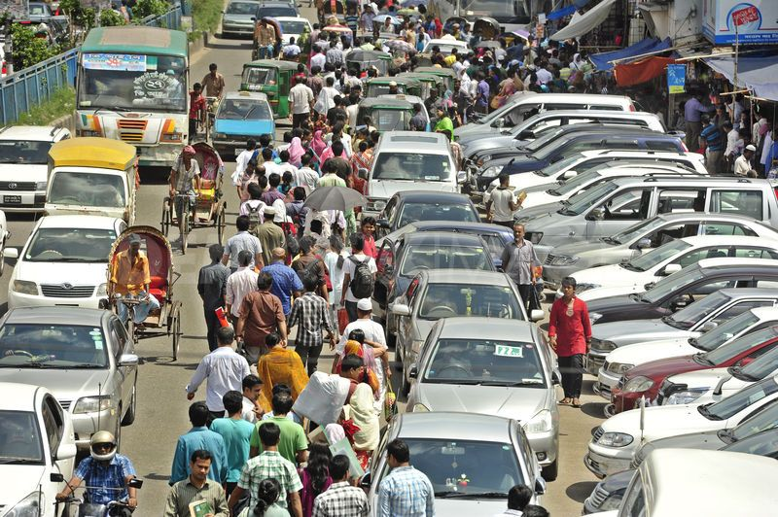
haphazard (adj)
disorganized; random
ard = always

Slide 8
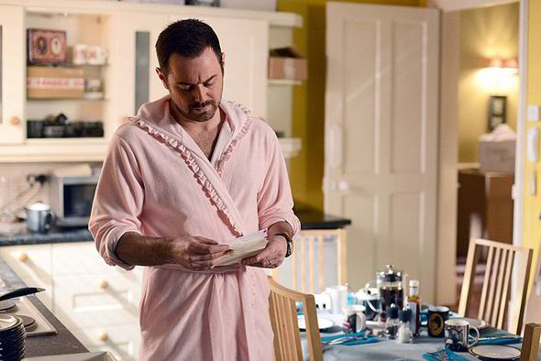
innuendo (n)
an indirect remark, gesture, or reference
in = in or not
endo = within

Slide 9
mitigate (v)
alleviate; lessen; soothe
ate = cause

Slide 10
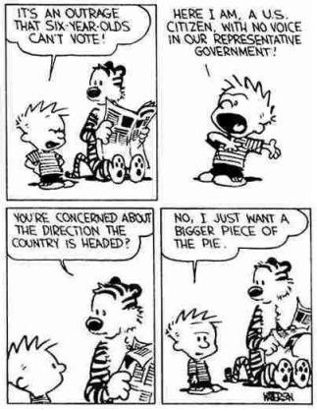
pertinent (adj)
relating to the matter at hand
per = through

Slide 11
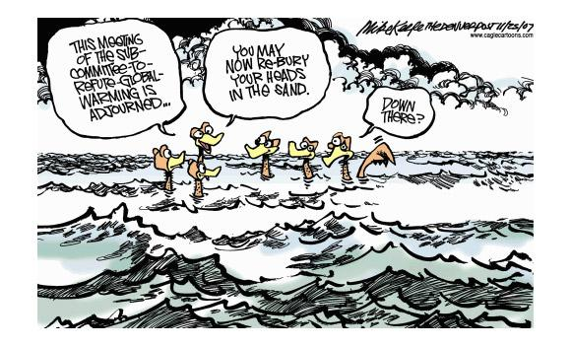
refute (v)
challenge; disprove
re = again

Slide 12
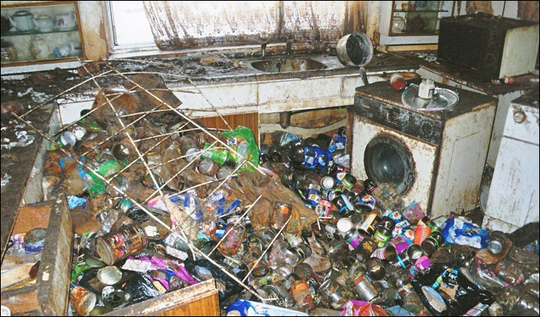
squalid (adj)
foul; filthy

Slide 13
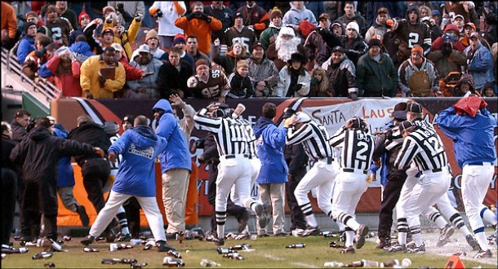
unruly (adj)
not submitting to discipline; disobedient
un = not

Slide 14
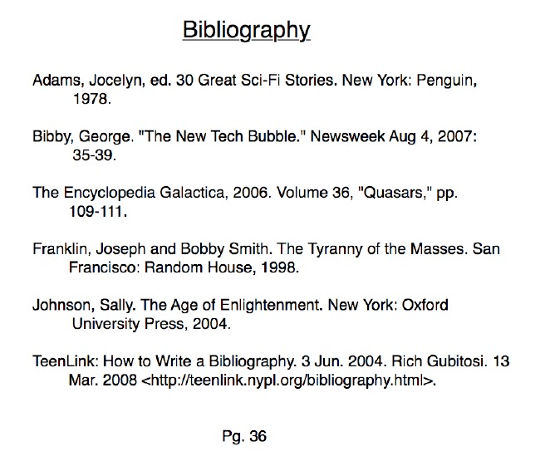
bibliography (n)
list of publications
biblio = book
graph = write

Slide 15
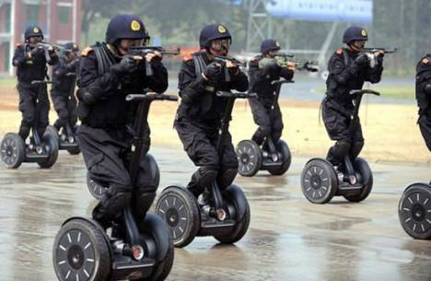
cupcake (n)
a sweet and innocent child who becomes sardonic after continual exposure to malevolent pedagogues

Slide 16
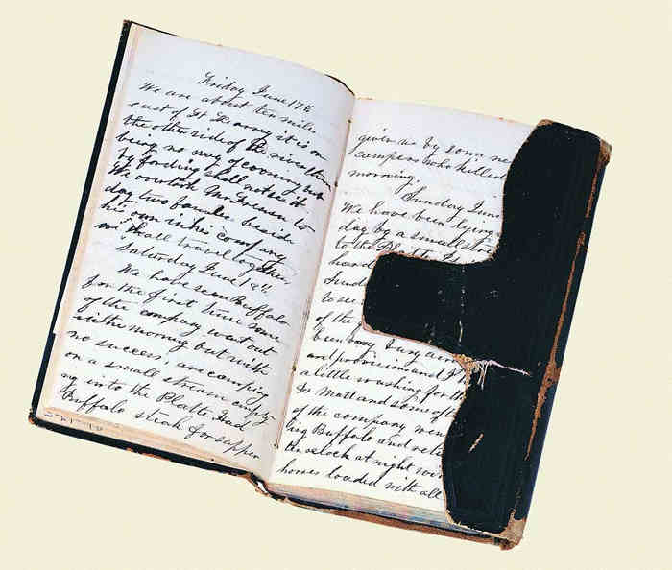
diary (n)
personal record of life’s events
dia = across

Slide 17
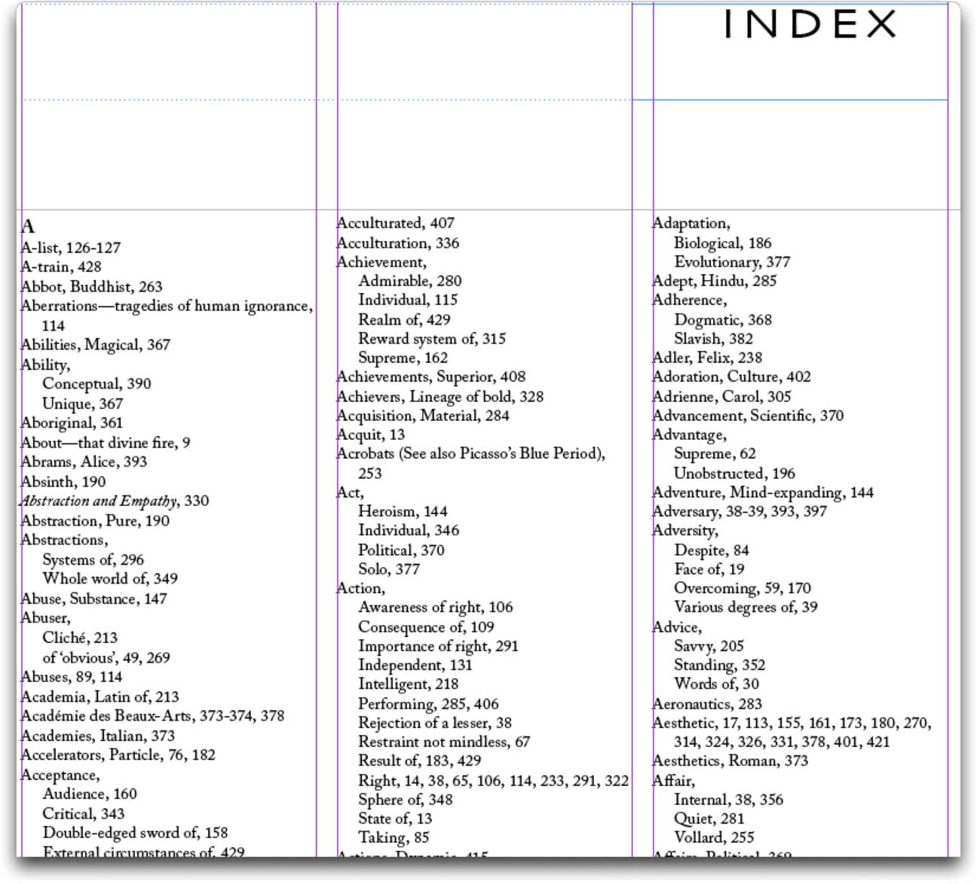
index (n)
alphabetical reference list
in = in or not

Slide 18
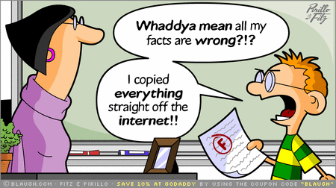
plagiarize (v)
copy something from another person’s work
ize = make

Slide 19
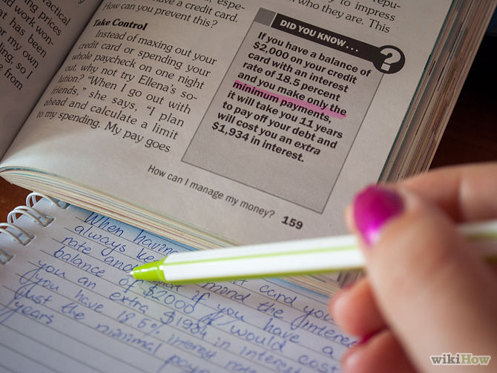
paraphrase
(v) rephrased version
(n) rephrase and simplify
para = beside

Slide 20
periodical (adj)
published regularly
per = through

Slide 21
reference (n)
source of information
re = again
fer = carry

